Slide 1

Analysis 1: Foundations of Modeling Lesson 2.2: Variables and linear algorithms
Analysis Team, 2020/2021

Slide 2
Overview of this lesson: Variables and linear algorithms
Variables
Purpose, scope, assigning and changing value(s), variable name, variable type
Comments
Linear algorithms

Slide 3
Overview of this lesson: Variables and linear algorithms
Learning objectives:
Learn what is a variable, how to assign a value to it and how to use it in expressions.
Learn variable types and how to convert from one type to another in Python.
Understand linear algorithms and solve simple problems with linear algorithms.
At the end of the lesson a student should be able to:
Use variables to store values of different types.
Solve a simple problem requiring a linear algorithm, consisting of input, processing and output. Student should also be able to show the solution algorithm via flowchart and implement it in Python.

Slide 4
Variables

Slide 5
What is a variable?
In computer science, VARIABLES are used to 1) store information…
… which is referenced and manipulated in a computer program.
Variables also provide a way to 2) label data with descriptive names.
A variable is a memory location in a computer that contains a certain value.
That value can change during the execution of the program, hence its name – variable.

Slide 6

What is a variable?
The easy way to understand a variable is to think of it as a box.
In computer science, in that box (variable) we put information.
Let’s say we want to store the number 5. We pick a box, give some name to it (so we can reference it), for example A. Then we put a number 5 inside box (variable) A. Simple. ☺

Slide 7
What is variable?
Remember, the sole purpose of VARIABLE is:
Store information
Label information

Slide 8
Variables in Python
The best way to get used to variables is to experiment.
Start Pyzo / Spyder.
Python is a dynamically typed language, so to use a variable you have to assign some value to it.
Let’s use the same example: create variable A and assign to it number 5.
Assigning values in Python uses the following syntax:
variable_name = value
! Note: “=” in this case is assignment sign and not to be confused with “equal” in mathematics. We will revisit this later.

Slide 9
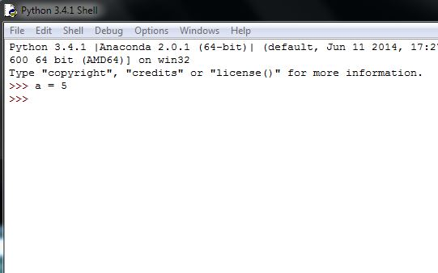
Variables in Python
In a Python shell type:
a = 5 (PRESS ENTER)
The shell will go to the new line. Although at the first glance, you may think nothing has happened, after you pressed ENTER, Python created variable “a” for you and assigned to it number 5.
If you did something wrong, you would get an error message.

Slide 10
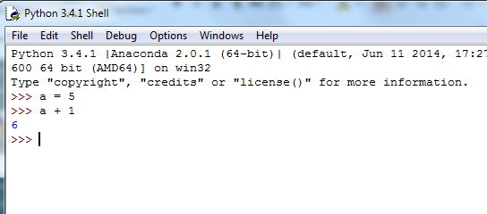
Variables in Python
We can test if everything went well by writing simple mathematical expressions like we did in the previous week.
Try: a + 1 (PRESS ENTER)
What did you get?
Why?

Slide 11
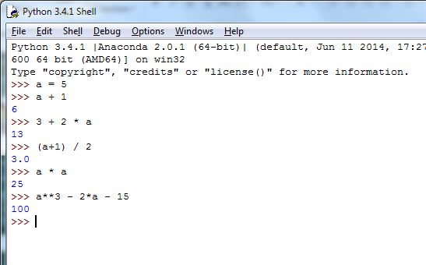
Variables in Python
Practice writing different expressions.
Try: 3 + 2 * a
Try: (a+1) / 2
Lets say that a was the side of a square. Then we can calculate its area by typing:
a * a
You can use this variable now as many times as you want / need.
Try: a**3 – 2*a – 15

Slide 12
Variable scope
Each variable has its SCOPE. It determines WHERE in the program is VARIABLE available for use.
In this introductory course we will only mention this topic and not go further.
For now, remember that every variable we use is a GLOBAL variable.
Global variables are visible throughout the program. In Python they exist from the point they were created, until the termination of the program (for now, this is our Python shell).
Therefore, if you close the shell, re-launch it again, and try using “a”, you will get an error.

Slide 13
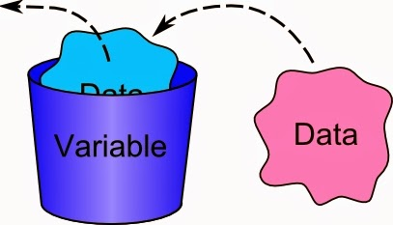
Changing variable value
Let’s go back to our a = 5 example.
You have noticed that no matter how many times we use the variable a, its value will not change.
If we want to change the value, all we have to do is assign a new value to the variable.
By doing so, the old value will be discarded, and our “box” (variable), will now hold the new value.

Slide 14
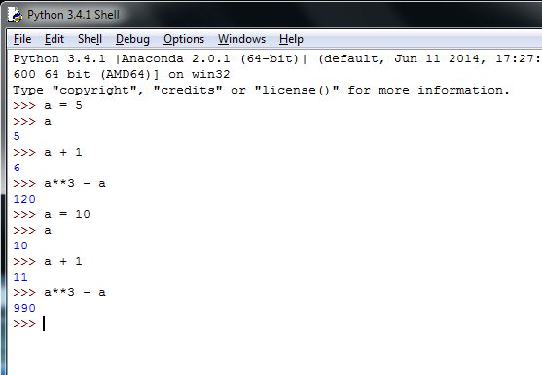
Changing variable value
Let’s put it to practice …
Try:
a = 5 (ENTER)
a (ENTER)
a + 1 (ENTER)
a**3 - a (ENTER)
Next, change the value; try:
a = 10 (ENTER)
a (ENTER)
a + 1 (ENTER)
a**3 - a (ENTER)
What do you notice?

Slide 15
Changing variable value
When assigning a value to the variable, it doesn’t have to be an explicit value like we did so far.
You can make a complex expression and assign its result.
In that case, Python will first “look” at the right side of the “=” sign, calculate the expression, and then assign that value to the variable name to the left of the “=” sign.
The syntax in essence doesn’t change:
variable_name = expression

Slide 16
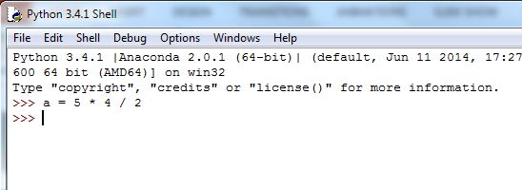
Changing variable value
Try:
a = 5 * 4 / 2
Ok. Let’s see if you have been paying attention. How can we check what is the value of variable “a” now?

Slide 17
Multiple variables
You will use more than one variable.
Remember that the number of variables is limited only by computer’s memory and at this stage is more than you will need.
Let’s introduce a new variable … b.

Slide 18

Multiple variables
Arguably, the best way to learn programming is to try to break a program on purpose.
Then understand why it went wrong.

Slide 19
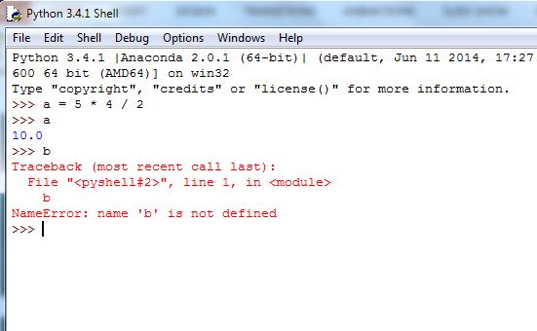
Multiple variables
Try typing “b”:
b (PRESS ENTER)
What happened?
Congratulations! This is your first programming error! ☺
Let’s take a closer look.
… “name ‘b’ is not defined …”
Why did this happen?
Because we tried to use variable that is not initialized yet, and Python didn’t know what to do.

Slide 20
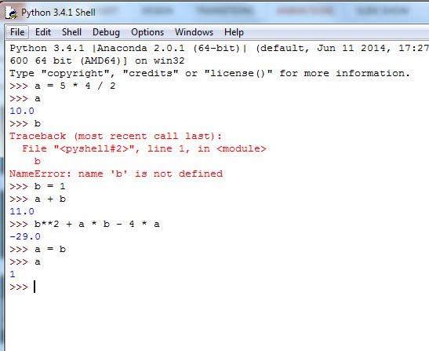
Multiple variables
Let’s fix it. Type:
b = 1 (PRESS ENTER)
Experiment a bit with both variables.
Try:
a + b
b**2 + a * b – 4 * a
You can also assign the value of one variable to another:
a = b
a

Slide 21
Variable increment
Let’s take a look at a special case that you will often encounter in programming. Consider the following line:
a = a + 1
Is this correct?
In mathematics this wouldn’t make sense as:
a = a + 1
a – a = 1
0 = 1 (… and this is when the universe implodes)

Slide 22
Variable increment
In computer science this is a legitimate statement.
a = a + 1
The reason is that “=” is not EQUAL sign, but used as assignment (binding) operator.
Hence, the right part would be evaluated and then, the new value bound to the variable a, effectively changing it.
Let’s say a = 5, then
a = a + 1
a = 5 + 1
a = 6
Therefore, by executing this line, we increment variable a by one, from 5 to 6.

Slide 23
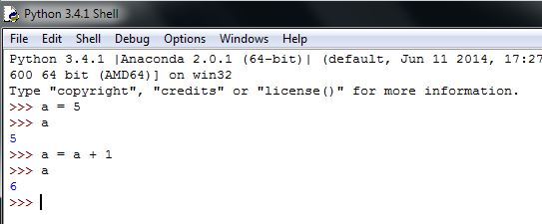
Variable increment
Try:
a = 5 (PRESS ENTER)
a (PRESS ENTER)
a = a + 1 (PRESS ENTER)
a (PRESS ENTER)

Slide 24
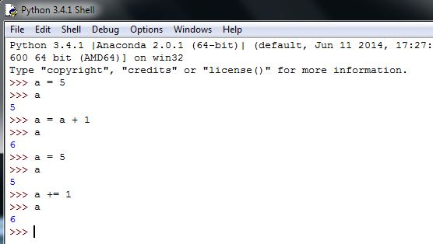
Variable increment
In the future you may encounter the operator “ += ”
“ += ” takes the value to the left, adds it to the expression on the right, and then assigns it to the left.
You can try:
Try:
a = 5 (PRESS ENTER)
a (PRESS ENTER)
a += 1 (PRESS ENTER)
a (PRESS ENTER)
We will not use it at this course.
In a similar way you can use (-=, *=, …)

Slide 25
Variable names
“Officially, a variable name in Python can be any length and can consist of uppercase and lowercase letters ( A-Z , a-z ), digits ( 0-9 ), and the underscore character ( _ ). An additional restriction is that, although a variable name can contain digits, the first character of a variable name cannot be a digit.” - from realpython.com
For simplicity, we used “a” and “b” so far. But you can name your variables any way you want. You can label them: a, A, Hogeschool, Daisy, hax0r, etc.
Please be careful that Python makes distinction between upper and lower case. Therefore a and A are two different variables.
TIP: try to use logical names and keep it simple. Like in your home, you could label your coffee box as sugar, but what would be the point?

Slide 26
input() function
Together with variables, we can introduce a new Python function: input().
You will use input function to assign a value to the variable that will be inputted by the user.
To let user input value to the variable A you can use:
A = input()
Also, we can’t expect the user to know what is expected of him, so it is good practice to give him a message. We do it like this:
A = input("Please enter integer value")

Slide 27
input() function
Finally, we want to assign the input from the
user to our variable. Therefore, we should add
variable name and assignment operator.
Let’s take a closer look:
var = input("text-for-the-user")
You can opt to give a message to the user or skip it.
If you want to output a message, add quotes (single or double)
and type your message inside.
Input is a function and as such must begin and end with parenthesis ().
For now just remember that after keyword input you must use ( and at the end
you must use ).
This is the keyword that tells Python which command we want to use

Slide 28
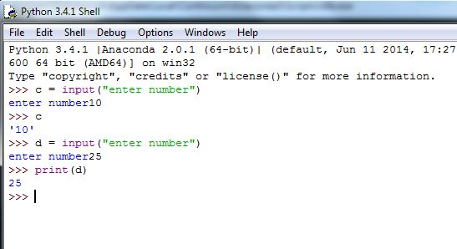
input() function
Practice makes perfect …
Try:
c = input(“enter number”)
c
We can combine with print() we learned before:
d = input(“enter number”)
print(d)
Notes:
! Note: when we use print() to print the value of the variable we don’t use quotes. If we did, it would just print character d.

Slide 29
Variable types
You might have noticed that when we printed variables c and d, Python returned results inside of single quotes. Why?
To understand what happened, we have to look at variable types.
Different programming languages have different data types.
Low-level programming languages typically have data types that are close to the way the computer works. Higher-level programming languages are usually more “relaxed” when dealing with data types (for example, not making the difference between integers and floats).

Slide 30
Variable types
There are many different data types in Python.
For now we will distinguish between:
Numerical
Strings
Logical
Numerical data types contain numbers such as integers and floats (e.g. 1, 3, 205, -4, -103, 1.5, -0.0003, …).
Strings are just sequences of characters. To make sure Python knows we are dealing with strings, they are always written inside quotes (“Hello World”, “Rotterdam”, “1234”, “-12.34”, “assdawea!@#!”
Logical take values TRUE or FALSE

Slide 31
Variable types
If we write a = 5, we have assigned to the variable a value 5.
If we write a = “5”, we have assigned to the variable a string with character “5”.
It is a common mistake to try to run expression with different data types. If someone asked you to compute:
“Tuesday” + 10 – “orange” * 2
What would you answer?
In the same way, the computer wouldn’t know what is the answer, so you would be given an error.

Slide 32
Variable types
Lets say we have four variables, a, b, c, d. We will assign integers to the first two and strings to the remaining.
a = 5 b = 1 c = “5” d = “1”
If we add a and b we would get 6, as
a + b = 5 + 1 = 6
If we add c and d, Python would actually concatenate two strings, giving us “51”. That is because
c + d = “5” + “1” = “51”
However, trying to add a and c (or a+d, b+c, b+d) will result in an error.
a + c = “error”

Slide 33
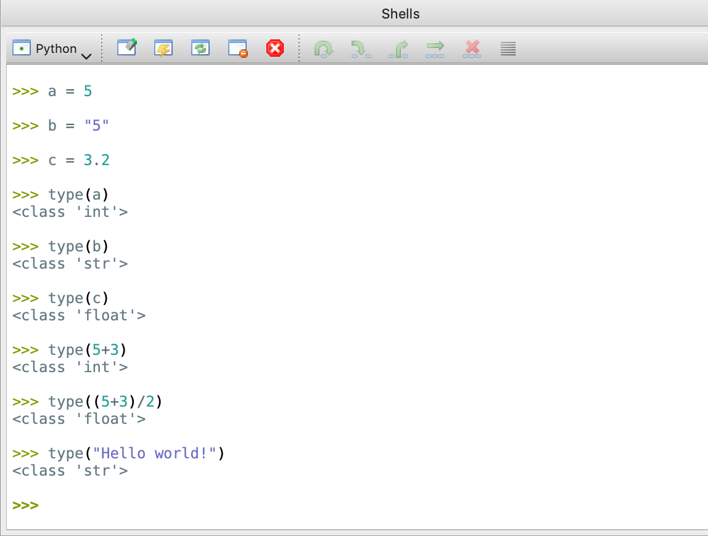
type() function
Python has a built-in function that you can use to find the type.
type(object) - prints the type of a given data object.
Try:
Assign some values to variables a, b, and c (we chose, int, string and float)
Use type() to find the type of those variable.
You can also use expressions in type().

Slide 34
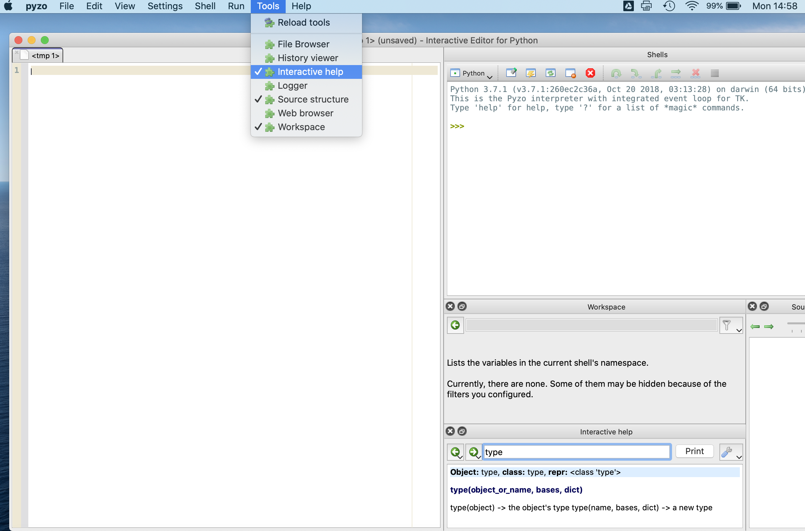
Interactive help in Pyzo
In Pyzo you can use interactive help to find more information about any Python command.
Select Tools, and then click on Interactive help.
Place Interactive help window wherever it suits you.
In the edit box of the Interactive help window, type the command you want to know more of, and press ENTER.

Slide 35
Variable types
Python offers an easy way to convert from integer to string and vice-versa.
int(string) - converts variable “string” to integer
str(n) - converts variable n to string.
Please be careful. You can always convert an integer to a string, but not all strings can become integers. For example, “5” can be converted to 5, but “orange” doesn’t have any numerical mapping. If you want to go that far, you have to make a mapping on your own.

Slide 36
Variable types
Going back to our input example, Python has no way of knowing what will user enter, hence it will always treat input as string.
If we want to use a number, we can convert (cast) it to integer with int() function.
c = input(“enter value”)
c = int(c)
As long as the user provides numerical input, everything will run fine. Otherwise, you will get an error at the moment of conversion.
You can write the expression from above in one line:
c = int(input(“enter value”))
Notes:
At this stage, don’t go into functions and composition. Just make sure students have a way to get numerical input from the user.

Slide 37
Comments
Comment - programmer-readable explanation or annotation in the source code of a computer program.
To put a comment in Python use # sign.
Everything following # will be ignored by Python interpreter.
To comment multiple lines open with 3 quotes (either single ' or double "), write comments, and then close with another 3 quotes of the same type.

Slide 38
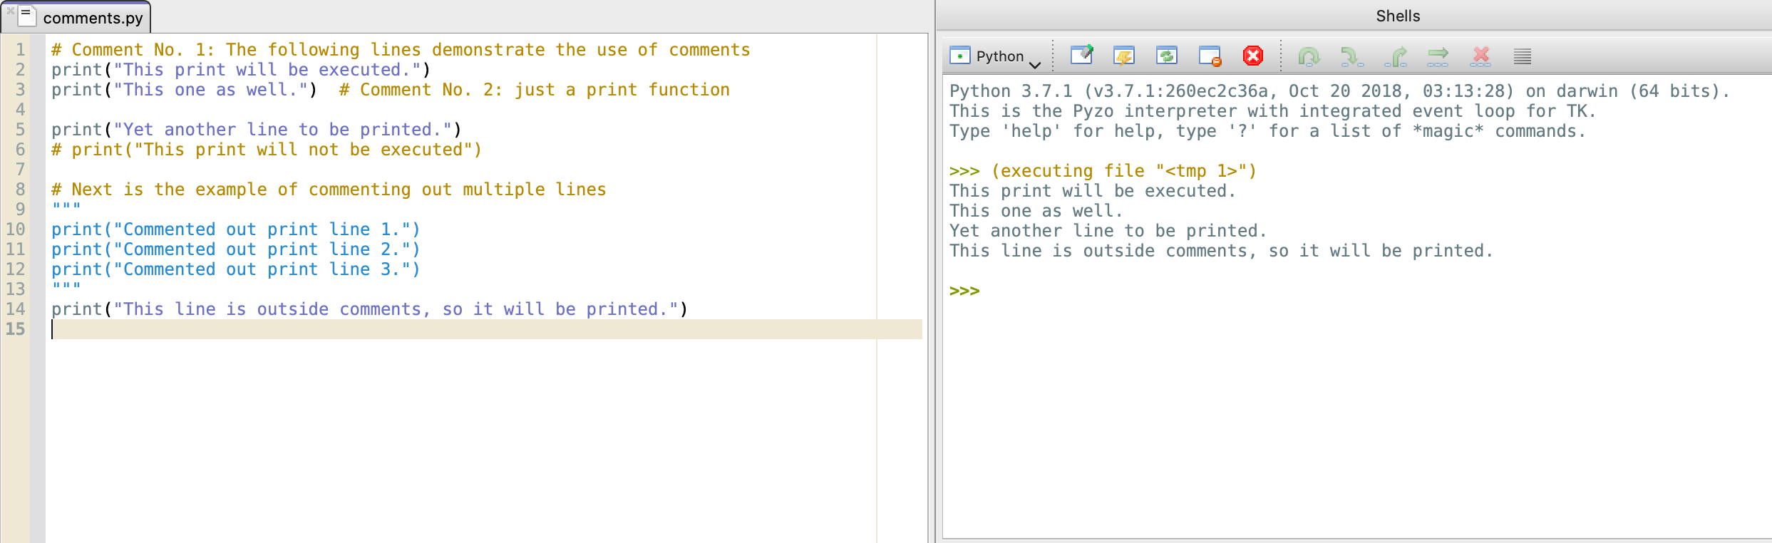
Comments - example

Slide 39
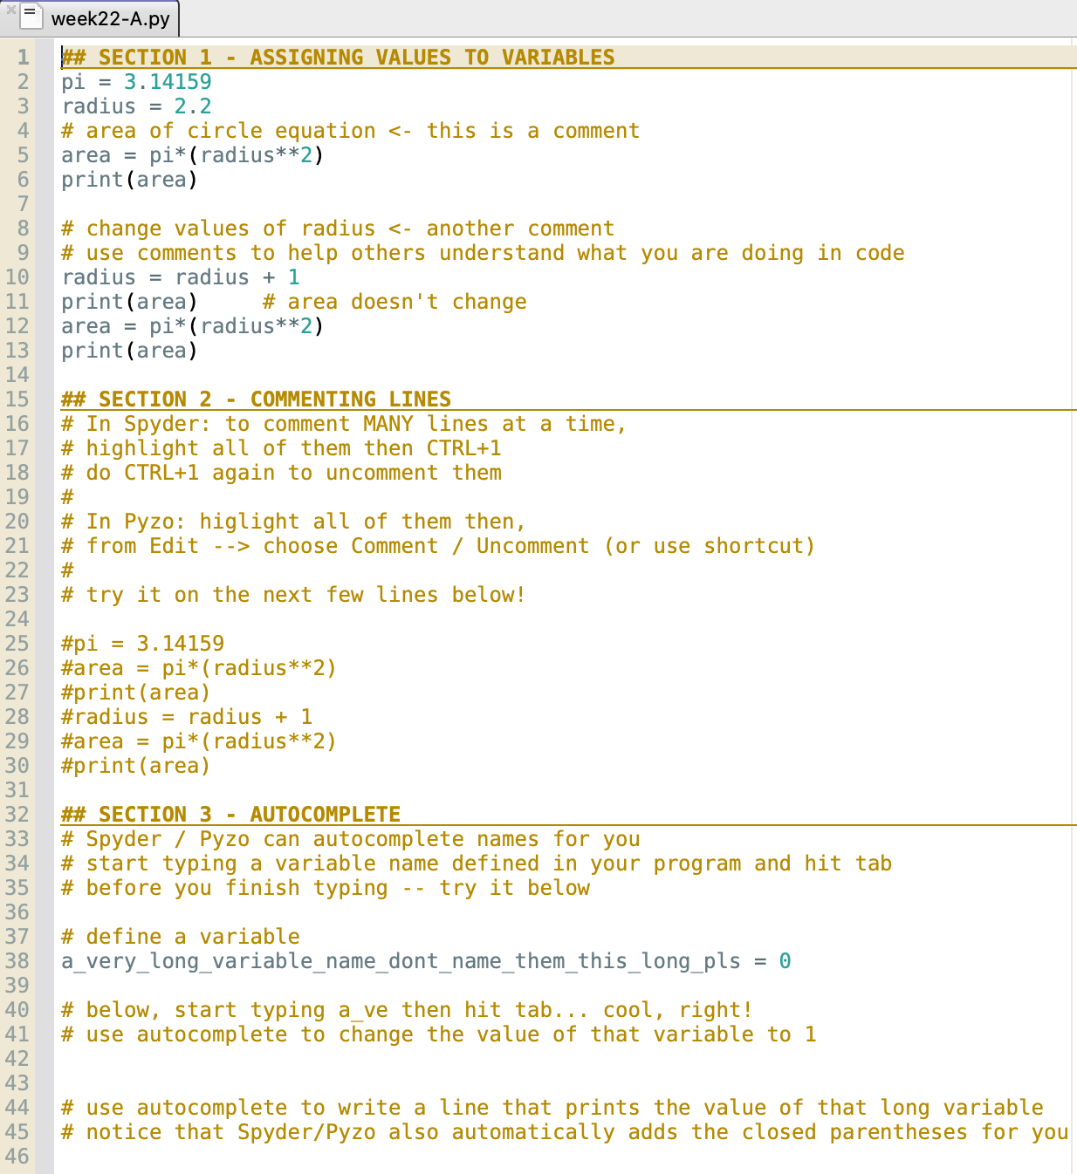
Practice with Pyzo (Spyder)
Open file week22-A.py in Pyzo or Spyder.
Use the provided lines of code to experiment how to:
Assign values to variables
Comment and uncomment lines of code
Also try using Pyzo’s / Spyder’s feature of commenting multiple lines
Use Pyzo’s / Spyder’s autocomplete feature

Slide 40
Linear algorithms

Slide 41
Remember algorithms from lesson 1.2
In the previous week we mentioned 3 different types of algorithms.
Which ones did we mention?
What are linear algorithms?

Slide 42
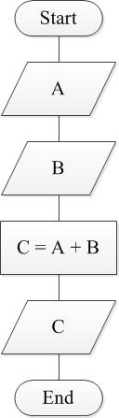
Linear algorithms
Linear algorithms are algorithms where every step is executed once and only once.

Slide 43

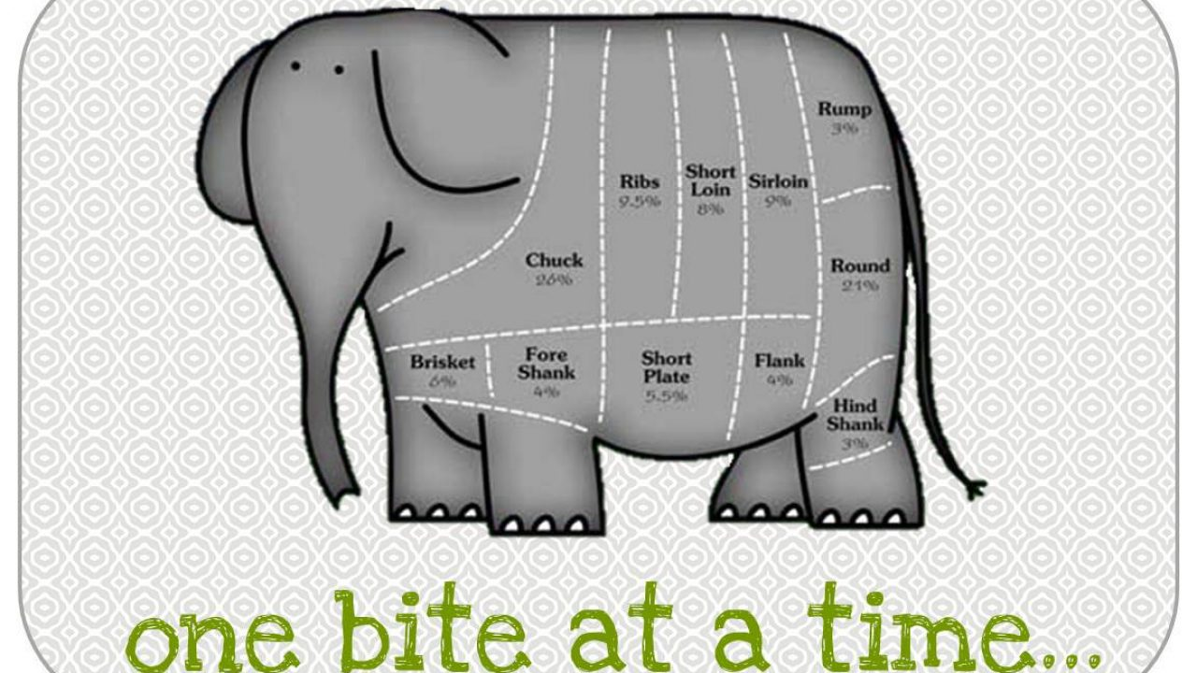
Problem solving
How do you eat an elephant?
One bite at a time …

Slide 44
Linear algorithm 1 - rectangle
Problem: Write a program that will calculate and print the area of a rectangle, for width and length given by the user.

Slide 45
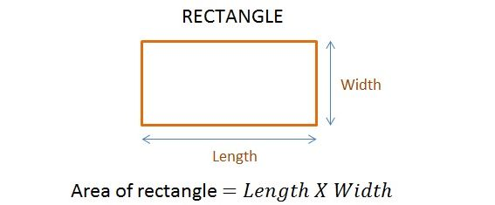
Linear algorithm 1 - rectangle
To “eat” our first “elephant” let’s break it into smaller pieces (divide et impera):
Problem: Write a program that will calculate and print the area of a rectangle, for width and length given by the user.
What do we have to do?
What is given?
How do we do it?
print the area of a rectangle
width and length, from user
calculate area

Slide 46
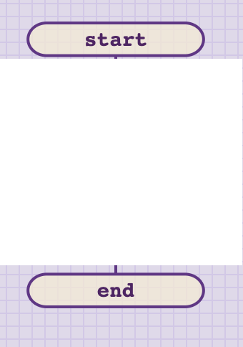

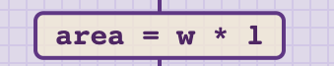
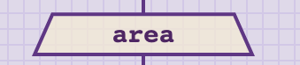
Linear algorithm 1 - rectangle
What do we have to do?
What is given?
How do we do it?
print the area of a rectangle
width and length, from user
calculate area

Slide 47

Linear algorithm 1 - rectangle
All we have to do now is type our solution using Python syntax.
Launch Pyzo / Spyder.
Instead of writing in the console, create a new file.
Save it as rectangle.py
Enter the code according to the algorithm.
Run it.

Slide 48
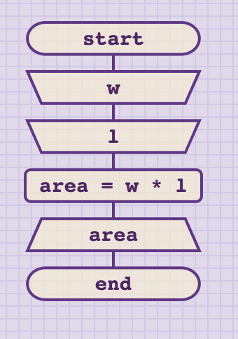
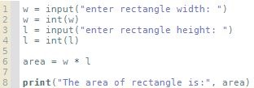
Linear algorithm 1 - rectangle

Slide 49
Linear algorithm 1 - rectangle
Provided there were no syntax errors, our rectangle.py should run fine. If there were errors, correct them, or ask teacher for help.
Now when we ensured that our program is running, we need to test if it is giving the desired output. To do this, we select input for which we know the correct result and compare it with the output given by the computer.
Preferably, we do several cases, checking the most common and border scenarios. Proper testing will be taught at other Analysis courses.

Slide 50
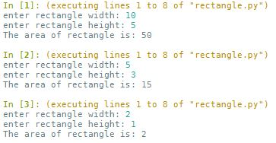
Linear algorithm 1 - rectangle
Lets pick 3 scenarios:
1) w = 10, l = 5,
area = 10 * 5 = 50
2) w = 5, l = 3,
area = 5 * 3 = 15
3) w = 2, l = 1,
area = 2 * 1 = 2
Next, run program 3 times and enter these input values. Compare outputs.

Slide 51
Linear algorithm 2 - perimeter
Exercise:
Modify rectangle.py to also calculate and show perimeter of the rectangle. Perimeter is calculated using formula:
Perimeter = L + W + L + W = 2*L + 2*W
Write the algorithm and flowchart first. Then apply it to the Python code.
Time: 5 – 10 minutes.

Slide 52
Linear algorithm 3 - purchase
Exercise:
You are going to the store to buy item X.
Write the algorithm that will ask the user (you) for the name of item X.
Then ask the user for the price of item X.
Finally, ask the user for desired quantity of item X.
Based on input, calculate how much you have to pay.
Write the message in the form: “To purchase N units of X you must pay M euros.”

Slide 53
Linear algorithm 3 - purchase
If you get stuck, ask yourself the following questions:
What do we have to do?
What is given?
How do we do it?
Write the algorithm that will ask the user (you) for the name of item X.
Then ask the user for the price of item X.
Finally, ask the user for desired quantity of item X.
Based on input, calculate how much you have to pay.
Write the message in the form: “To purchase N units of X you must pay M euros.”
Notes:
The text box on the right is for reference only. The answer is not explicitly given, but is contained in the text.

Slide 54
Linear algorithm 4 – exchange values
Problem: Write a program that will ask user to input two numeric variables A and B. Then exchange their values and print their results.
For example, if user enters A = 5, B = 3, the program should output
A = 3, B = 5

Slide 55
Linear algorithm 4 – exchange values
Problem: Write a program that will ask user to input two numeric variables A and B. Then exchange their values and print their results.
For example, if user enters
A = 5, B = 3, the program
should output A = 3, B = 5
Let’s tackle the problem in the same way …
What do we have to do?
Print A and B
What is given?
A and B
How do we do it?
We exchange values
So, A = B and B = A

Slide 56
Linear algorithm 4 – exchange values
So close, yet so far!
In Computer Science there are only 10 types of programs.
-------------
Those that work flawlessly, and those that don’t.

Slide 57
Linear algorithm 4 – exchange values
If we were to write an algorithm and implement it according to the previous proposal, we wouldn’t get the desired result.
If the input was A = 5, B = 3, we would either get A = 3, B = 3, or A = 5, B = 5 (depending on the order you made the value assignment)
You don’t have to take my word for it. Try to implement it. We learn through trial and error.

Slide 58
Linear algorithm 4 – exchange values
This is the problem!
When we assign the value variable B holds to variable A, we lose A’s former value (5).
Let’s zoom in and figure out the problem.
Let’s try one step at a time…
A = 5
B = 3
A = B
B = A
print(A,B)
How do we do it?
We exchange values
So, A = B and B = A
A = 5
A = 5, B = 3
A = B => A = 3 A = 3, B = 3
B = A => B = 3 A = 3, B = 3
print(A, B) => print(3, 3)

Slide 59
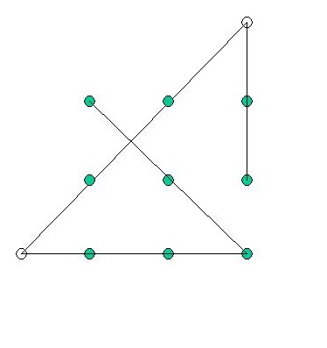
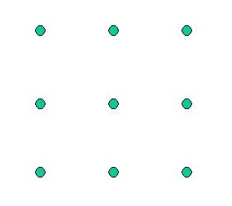
Thinking outside the box
As programmers we have to think outside the box. The following problem illustrates the concept well:
Connect all 9 dots with 4 straight lines without lifting (interrupting stroke)

Slide 60
Linear algorithm 4 – exchange values
Going back to our example; our problem is that we lose the former value of A when we do the assignment.
To solve it, we need a way to STORE that value somewhere.
How can we do it?
Remember, variables are “boxes” to store information.
So, we just need one more variable to temporarily hold the value.
(no one said we are not allowed to add additional variables)

Slide 61
Linear algorithm 4 – exchange values
Therefore, we can add variable T (as temporary).
Then solve the problem like this:
T = A T will store the value A has
A = B we destroy the old value of A and assign the value B has
but it is not a problem, since we safely stored it in T
B = T B can now take the value T has (which is original A’s value)
* At this point we no longer need T;
in other languages it could be deallocated;
Python will take care of this for us.

Slide 62
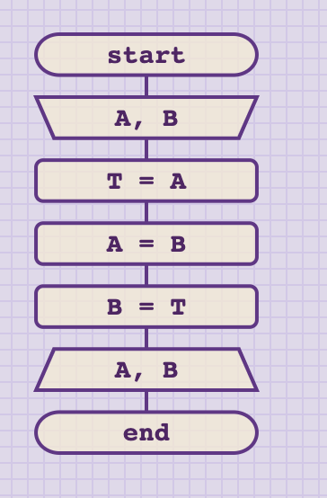
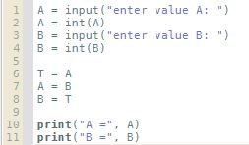
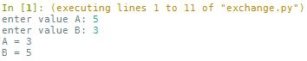
Linear algorithm 4 – exchange values

Slide 63
Linear algorithm 5 – extract digit
Problem: Write a program that will ask the user to input some numeric value. Then, print the last digit for the number the user has entered.
For example, if user enters N = 523, the program should print 3.

Slide 64
Linear algorithm 5 – extract digit
There is a huge collection of problems that tackle digit extraction.
In general, the solution requires manipulation with BASE NUMBER (check: numeral systems lesson), and careful selection of FLOAT, and FLOOR division and MODULO operation.
In this problem, it is straightforward what is input and output. We should only focus on HOW to get the desired result.

Slide 65
Linear algorithm 5 – extract digit
Applying the knowledge of numeral systems makes this problem easy. Dividing (FLOOR division) any number with its base will return all digits except the last as the quotient, and the last one as the remainder.
Let’s take a look:
(1234)₁₀ // 10 = 123
(1234)₁₀ % 10 = 4
The same can be applied to binary or any other base:
(1001)₂ // 2 = (100)₂
(1001)₂ % 2 = (1)₂

Slide 66
Linear algorithm 5 – extract digit
We conclude that this problem can be solved using MODULO operation for base 10.
D = N % 10

Slide 67
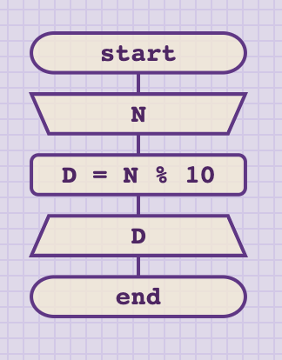
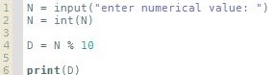
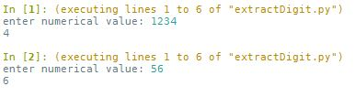
Linear algorithm 5 – extract digit

Slide 68
Linear algorithm 6 – middle digit (measuring learning objectives)
Exercise:
Write a program to ask user to input a THREE-digit number.
Then print out the digit in the middle.
Example: input: 236 output: 3

Slide 69
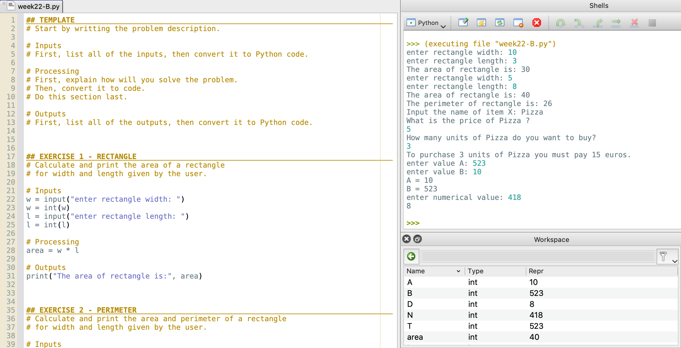
Code for the exercises 1-5
Python code for exercises 1-5 as well as hints for exercise 6 can be found in the file week22-B.py.
Either copy-paste each exercise into a new file and then run it.
Or comment out the parts you don’t need, and execute the entire file.
If you are using Pyzo, each exercise is given as a separate cell (starts with ##). You can run a single cell by clicking inside it and choosing Run → Execute cell from the menu.
Pyzo also allows you to highlight one section of the code and execute it line-by-line in the shell. For that option, highlight the code you want, then choose: Run → Execute selection.

Slide 70
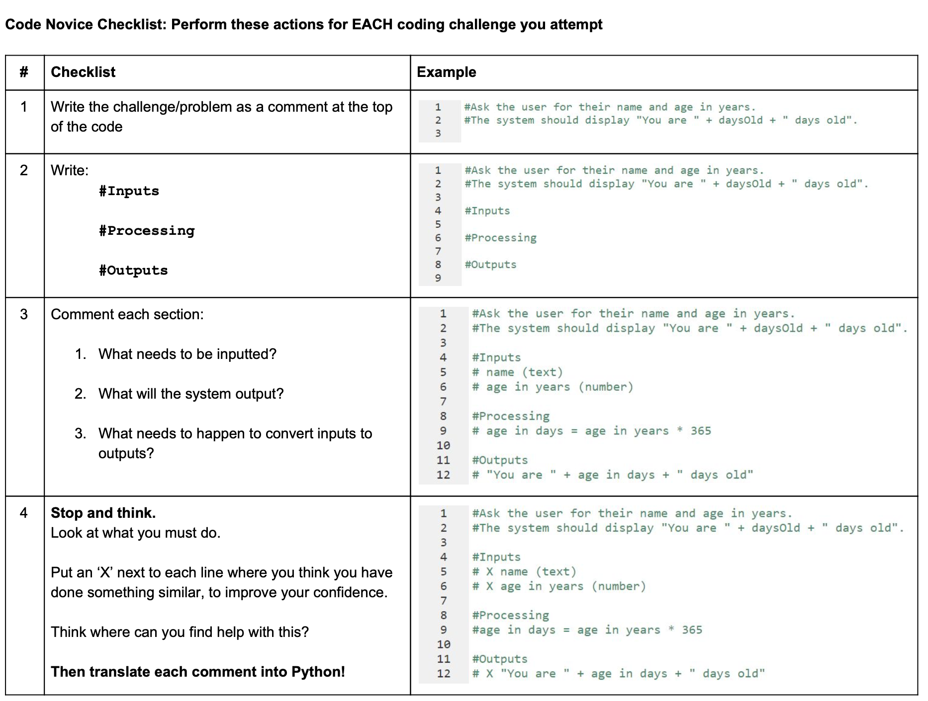
A template for novice programmers
Meta Cognition provided a template in the form of a checklist to help novice programmers.
You can find the template as MetaCog checklist.pdf.
Feel free to use it, until you develop a style of your own.
Notes:
Source: https://sites.google.com/view/trafalgar/design

Slide 71
Summary Quiz
What is a variable and what is its purpose?
How can you change the value of a variable?
Which three variable types did we mention? Which two did we use so far?
How do we read from the console? What type do we get?
Which functions can be used to convert from number to string and vice-versa?
What are linear algorithms?
How can you swap values between two variables?
What is a general approach to extract a digit from some number?

Slide 72
Summary
Variable is a memory location in a computer that contains certain value. The purpose of variable is to store and label information.
To change the value of the variable, you have to assign a new value either explicitly or through an expression.
So far, we mentioned three variable types: numerical variables, strings and logical variables. In our examples we mainly used numerical variables and occasionally strings.
To read from the standard input (console) we use input() function. It returns string type.
To convert from string to number we use int() function, and to convert number to string we use str() function.
Linear algorithms are algorithms where every step is executed once and only once.
There are many ways to swap values between two variables, but the easiest is to add another variable to temporary store the value of the first and then perform the swap.
To extract digits from the number you need to use floor division, modulo operation and know the base of that number.

